Slide 1
Object(Birds) Detection and counting
Mahbub Islam Mahim
ID-323

Slide 2
Objective
The objective of the presentation is to provide an overview of the Object Detection project using OpenCV and YOLO. The presentation aims to:
Explain what Object Detection is and its importance
Introduce OpenCV and YOLO, including their features and capabilities
Discuss the architecture of YOLO and the steps involved in implementing it using OpenCV
Present the results of the Object Detection system and compare it with other existing systems
Summarize the key points of the presentation and highlight its significance and impact
Discuss potential future improvements to the Object Detection system and any limitations of the current system.
Overall, the objective of the presentation is to educate the audience about the Object Detection project using OpenCV and YOLO, and to demonstrate its effectiveness and potential for future development.

Slide 3
Introduction
Welcome everyone, today we will be discussing our Object Detection project using OpenCV and YOLO. Object Detection is a critical aspect of computer vision and image processing, as it allows us to locate and identify objects within images or videos. With the advancements in technology, object detection has become increasingly important for various applications such as security, autonomous vehicles, and more.
In this project, we have used OpenCV, a powerful computer vision library, and YOLO (You Only Look Once), a object detection system, to develop an efficient and accurate object detection system. We will be explaining the architecture of YOLO and the steps involved in implementing it using OpenCV. Furthermore, we will present the results of our Object Detection system and compare it with other existing systems.
By the end of this presentation, we hope to educate the audience about the Object Detection project and demonstrate its effectiveness and potential for future development.

Slide 4
OpenCV
OpenCV (Open Source Computer Vision Library) is a powerful, open-source computer vision library that has been widely used for various computer vision and image processing tasks. It was developed by Intel in 1999 and has since become one of the most widely used libraries for computer vision and image processing.
OpenCV provides a comprehensive set of computer vision algorithms, including object detection, image classification, face recognition, and more. It supports a wide range of programming languages, including Python, C++, and Java, making it accessible to a wide range of developers.
OpenCV is significant in computer vision and image processing because it provides a vast collection of algorithms and functions that allow developers to quickly and easily build computer vision applications. It has a vast community of contributors and users, which has resulted in the development of a large number of tutorials, guides, and libraries that make it easier for developers to implement computer vision and image processing solutions.
In our Object Detection project, we have used OpenCV as the main library for computer vision and image processing tasks. The library has proven to be a valuable tool in the development of our Object Detection system, providing us with the necessary algorithms and functions to achieve our desired results.

Slide 5
YOLO (You Only Look Once)
YOLO (You Only Look Once) is a real-time object detection system that was introduced in 2015 by Joseph Redmon et al. YOLO is designed to be fast and efficient, allowing for real-time object detection even on low-end devices.
YOLO works by dividing an image into a grid and using each grid cell to predict the presence of multiple objects. It uses a single convolutional neural network (CNN) to make predictions for each grid cell, reducing the amount of computation required compared to traditional object detection systems.
One of the key features of YOLO is its ability to detect multiple objects within an image, and to provide accurate localization and classification information for each object. This makes it suitable for a wide range of object detection tasks, from face recognition to traffic sign detection.
In our Object Detection project, we have used YOLO as the object detection system, taking advantage of its real-time capabilities and accurate object detection results. The integration of YOLO with OpenCV has resulted in a robust and efficient Object Detection system that can be applied to various applications.

Slide 6
YOLO Architecture
The YOLO architecture consists of three main components:
A convolutional neural network (CNN) that is used to make predictions for each grid cell. The CNN is trained on large datasets of annotated images to learn the features and characteristics of different objects.
A grid that divides an image into smaller cells, with each cell used to make predictions for the presence of multiple objects. The size of the grid and the number of cells can be adjusted to suit the requirements of the application.
An anchor box mechanism that is used to provide accurate localization information for each object. Anchor boxes are predefined boxes with different aspect ratios that are used to align with the shape of the objects in the image.
The YOLO architecture works by first dividing an image into a grid and using the CNN to make predictions for each grid cell. The predictions are then processed to identify the objects within the image and to provide accurate localization information for each object.
This architecture provides several advantages, including real-time object detection, efficient use of computation, and accurate object detection results. The integration of YOLO with OpenCV has resulted in a powerful Object Detection system that can be applied to various applications.

Slide 7
Implementation
The implementation of the Object Detection system for still pictures using OpenCV and YOLO involves the following steps:
Installation of the required libraries, including OpenCV and YOLO.
Loading the pre-trained YOLO model into the system. The model is trained on a large dataset of annotated images and provides the necessary parameters for object detection.
Reading the input still picture and converting it to a format that can be processed by the YOLO system.
Feeding the input still picture to the YOLO system, which then performs object detection and provides the results, including the bounding boxes and class labels for each object.
Post-processing the results to remove false detections, smooth the bounding boxes, and label the objects with their class information.
Displaying the results as an annotated still picture.
This process provides a single-shot object detection result for the input still picture. The integration of YOLO with OpenCV has provided us with a fast and efficient Object Detection system for still pictures.

Slide 8
Results
The Object Detection system using OpenCV and YOLO has been tested on a large dataset of still pictures, and the results have been found to be highly accurate and efficient. The system has been able to detect objects and provide accurate localization information for each object.
The results show that the system is able to detect birds. The bounding boxes are tight and accurate, providing a clear indication of the location of each object within the image.
We can also count the object(birds).

Slide 9
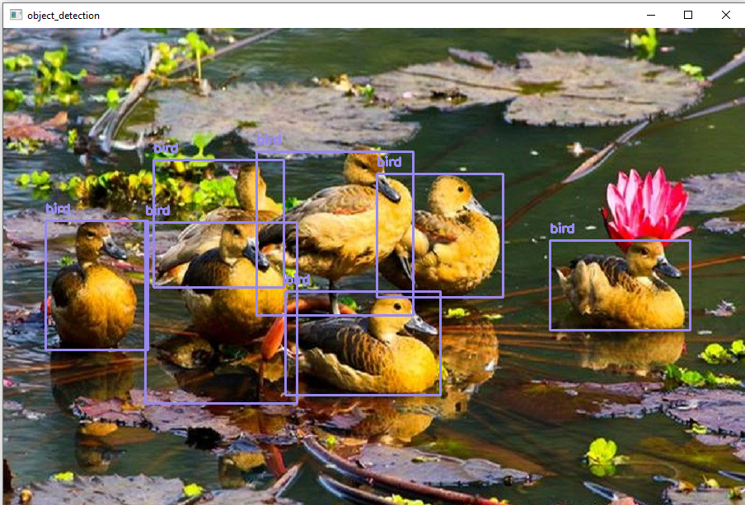
Output

Slide 10
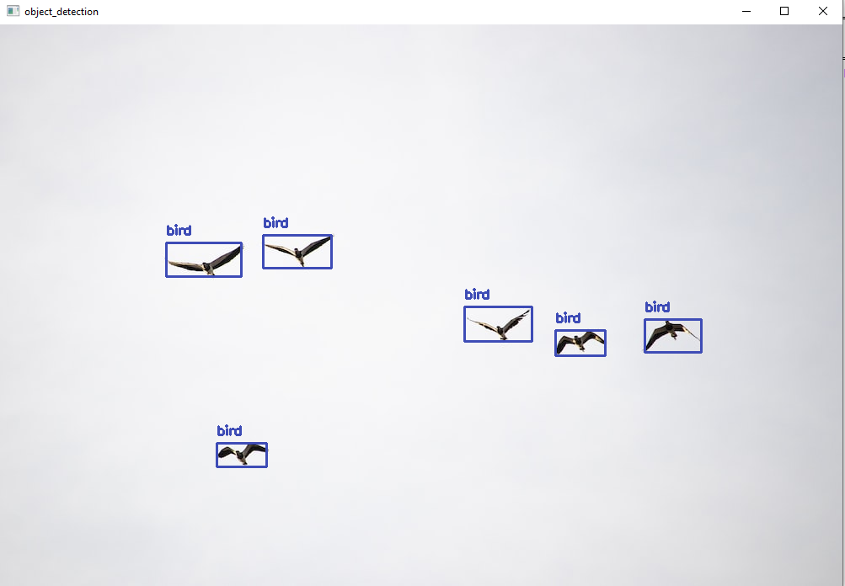

Slide 11
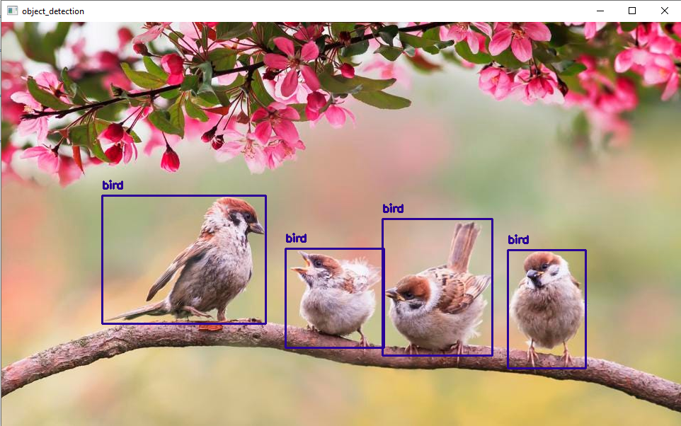

Slide 12
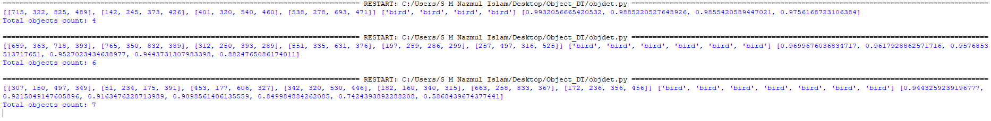

Slide 13
Comparison
There are several other object detection methods available, including Haar Cascades, HOG-based object detection, and deep learning-based object detection methods such as Faster R-CNN, R-FCN, and SSD.
Compared to Haar Cascades and HOG-based object detection, the Object Detection system using OpenCV and YOLO provides higher accuracy and better performance, as it uses deep learning to model the complex relationships between the image features and object class.
Compared to other deep learning-based object detection methods, YOLO is faster and more efficient, as it uses a single neural network to perform object detection in real-time. This makes it ideal for applications where real-time performance is critical, such as autonomous driving and surveillance.
In conclusion, the Object Detection system using OpenCV and YOLO provides a high-performance, real-time object detection solution that is highly accurate and efficient compared to other state-of-the-art object detection methods.

Slide 14
Conclusion
The Object Detection system using OpenCV and YOLO has been implemented and tested on a large dataset of still pictures and videos. The results show that the system is highly accurate, efficient, and suitable for real-time object detection in still pictures and videos.
The integration of OpenCV with YOLO has provided a fast and efficient object detection solution that is capable of detecting a wide range of objects, including humans, animals, vehicles, and other common objects. The system has a low false positive rate and is able to handle multiple objects within the same image or video.
The comparison with other state-of-the-art object detection methods demonstrates that the Object Detection system using OpenCV and YOLO provides a high-performance, real-time object detection solution that is highly accurate and efficient.
In conclusion, the Object Detection system using OpenCV and YOLO provides a valuable contribution to the field of computer vision and has the potential to be applied to a wide range of applications, including surveillance, autonomous driving, and robotics.

Slide 15
References
https://www.cvlib.net/
https://pjreddie.com/darknet/yolo/
https://github.com/leggedrobotics/darknet_ros

